Slide 1
FIRST AID AND HEALTH CARE
TRAINING CENTER
SIRILAK KAEWTHONG : INSTRUCTOR
PICHAMON WAIPROM : INSTRUCTOR

Slide 2
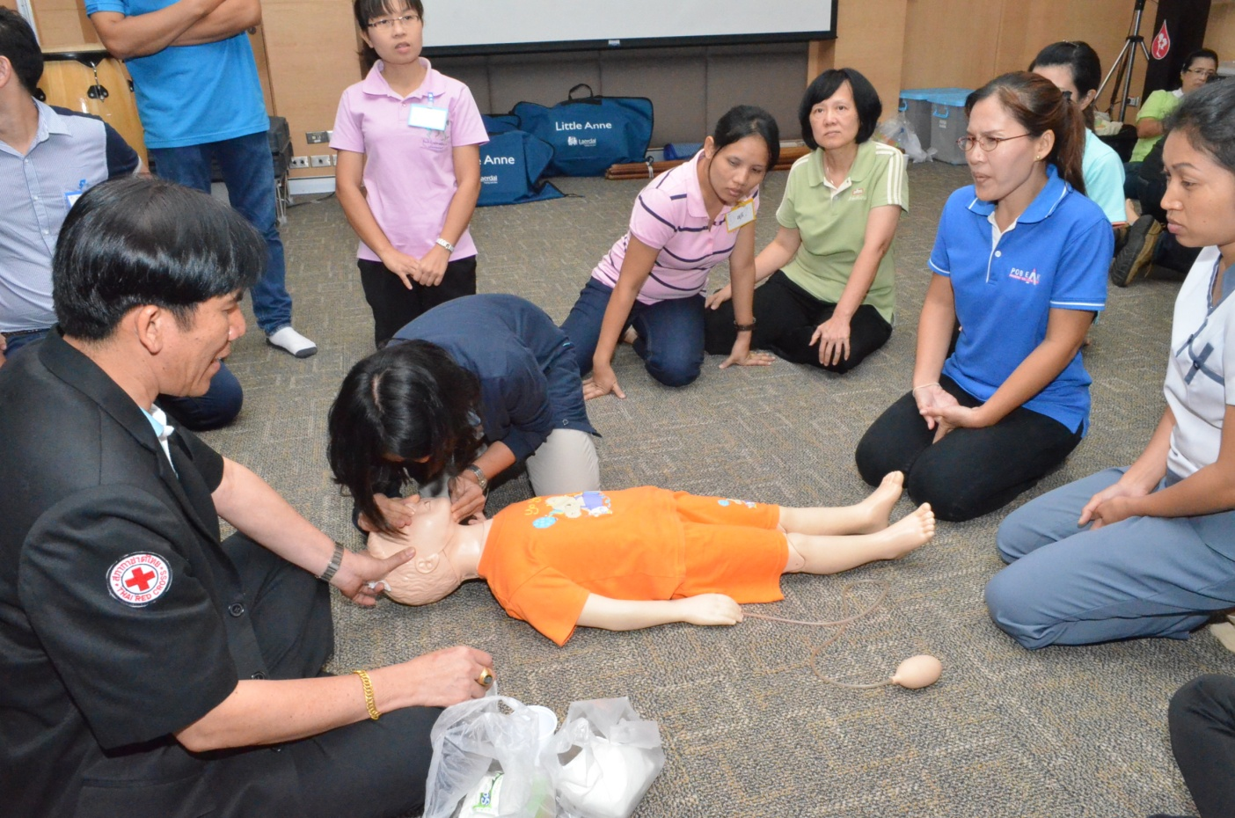
First Aid Training
Basic First Aid (1 day)
Standard First Aid (5 days)

Slide 3
First Aid Training

Slide 4
First Aid Training

Slide 5
First Aid Training

Slide 6
First Aid Training

Slide 7
First Aid Training

Slide 8
World First Aid DAy

Slide 9
World First Aid DAy

Slide 10
World First Aid DAy

Slide 11
World First Aid DAy

Slide 12
World First Day

Slide 13
World First Aid DAy

Slide 14
Empower community in First Aid and health care project

Slide 15
Empower community in First Aid and health care project

Slide 16
Empower community in First Aid and health care project

Slide 17
Empower community in First Aid and health care project

Slide 18
Empower community in First Aid and health care project

Slide 19
Empower community in First Aid and health care project

Slide 20
Empower community in First Aid and health care project

