Slide 1
Asia Pacific health South East Asia Terhi Heinasmaki 28 October 2013

Slide 2
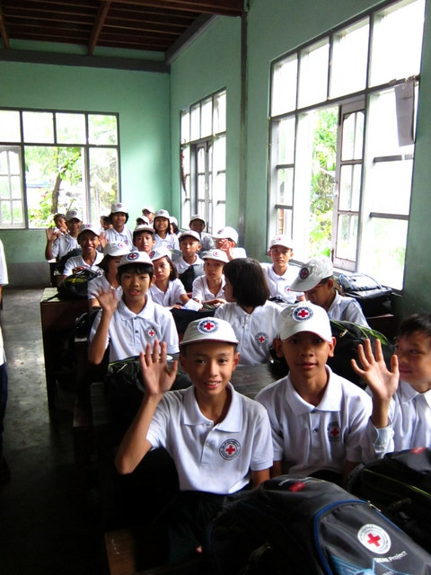
Layout: Highlights for health 2013
CBHFA/resilience
NCD
HIV
MNCH
VNRBD/ Cecilia
Emergency health, FA/ Jim Catampongan
WatSan/ Jay Matta

Slide 3
National society health programmes
NCD
HIV/AIDS
TB, Malaria
Polio, Measles
Dengue
Influenza
Disease-specific
Theme-based
Approach-focused
Aging population
Blood (VNRBD)
Climate change
Emergency health
First aid
MNCH
Nutrition
Pandemic preparedness
Psychosocial support
Road safety
Urban health
Water, sanitation, hygiene
Community-based
health and first aid
(CBHFA)
Global
Water and Sanitation
Initiative (GWSI)

Slide 4
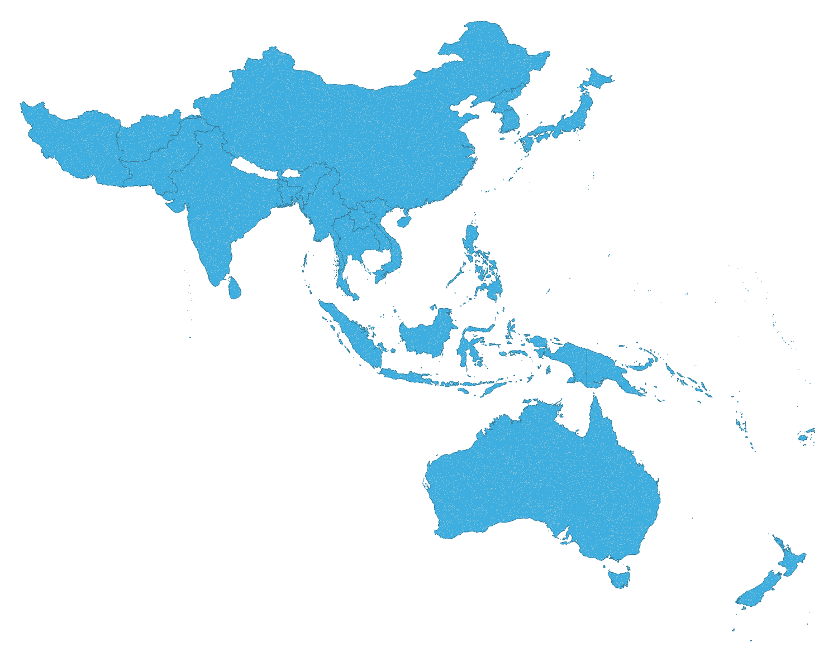
3
2
2
AP IFRC HEALTH RESOURCES
Zone health coordinators (3)
Regional health coordinator (4)
Country health delegate/officer (8)
Country Watsan delegate/officer (6)

Slide 5
Zone CBHFA workshop October 1-5 Sri Lanka
Integration, PMER and healthy lifestyle
PMER toolkit revision
Presenting new modules on NCDs and violence prevention
Field trip to integrated programming in SLRCS

Slide 6
CBHFA Global Mapping 2012
98 National Societies
80 NSs implementing 18 PNSs, IFRC and others supporting

Slide 7
CBHFA Mapping –Summary
98 NSs using CBHFA approach
As compared
to 2011
88% 1,637 facilitators
30% 30,384 volunteers are implementing CH programmes
53% 4,186 communities reached
23% 2,842,425 people reached
26% CHF 3.5 is the average cost per person per year

Slide 8
CBHFA Mapping – Integration
Disaster Risk Reduction (DRR) – 61%
Water and Sanitation – 57%
Epidemic Control and Emergency Health – 54%
HIV – 48%
MNCH/Immunization – 45%
Road Safety – 39%
TB – 34%
NCDs and Healthy lifestyle – 30%
Malaria – 30%
Organizational Development – 29%
Blood – 23%
Violence Prevention – 20%
No integration at all – 13%

Slide 9
CBHFA mapping 2012 SEA
 | Cambodia | CVTL | Indonesia | Laos | Myanmar | Philippines
Nr of beneficiaries | 24913 | 1.692 | 740 | 5,268 | 17,894 | 525,000
Cost per beneficiary | 7 CHF | 38 CHF | 2 CHF | 36CHF | 24CHF | 0,57 CHF
Partners | Finnish RC | IFRC | American RC, Spanish RC | Austrian RC | IFRC | Australian Japanese Spanish RCS, and Australian AID
Baseline done | yes | yes | yes | yes | yes | yes
Integration | WatSan | Malaria, TB, WatSan, DRR | Malaria, TB, Blood, WatSan, NCDs, Road safety, DRR, OD | WatSan, nutrition | DRR, Watsan, livelihoods | WatSan, EH, MNCH/Immunization, DRR and OD
Evaluation | 2013 | 2014 | - | 2012 | 2013 | -

Slide 10
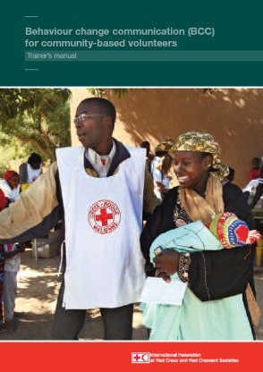
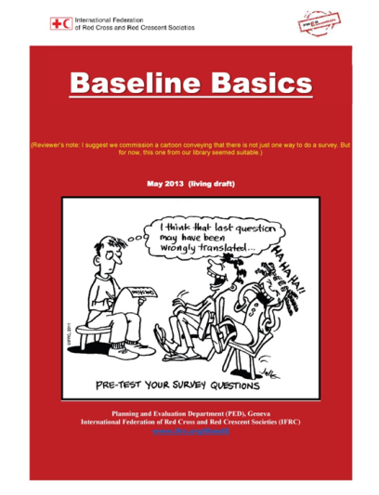
CBHFA New Global Tools
Behaviour Change Communication (BCC): instructions and technical materials to conduct a training course for trainers and community-based volunteers
Planning Monitoring Evaluation and Reporting (PMER) Toolkit: basics of setting up and using a monitoring and evaluation programme for CBHFA, review 2013
Baseline Basics
Sector-neutral guidance on evaluations (base- and endlines)
Healthy lifestyle module: volunteer, facilitator and community tools to tackle noncommunicable diseases
Violence Prevention module: Volunteer, facilitator and community tools to tackle violence prevention issues

Slide 11
CBHFA updates and plans
CBHFA e-learning
Generic Master Facilitator ToR, Agenda and Guidance
Research – Value of volunteers in community health
Research – Optimize the volunteer role in NCDs prevention and control
Global mapping (Jan-Feb 2014)
Evaluations: several NS evaluation to be added to database on FedNet
Mobile health, how to use phones in e.g. baselines
Fednet – community of practise/ Facebook

Slide 12
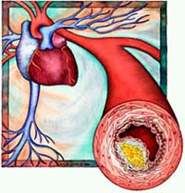
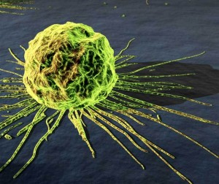
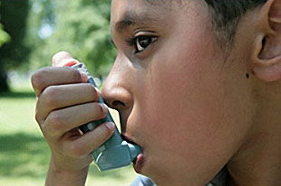
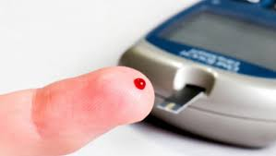
Noncommunicable diseases (NCDs)
cardiovascular diseases
(heart disease and stroke)
cancer
diabetes
chronic respiratory diseases
Notes:
Diseases which are not infectious
May result from genetic or lifestyle factors
Not including mental health and injuries

Slide 13
Shared risk factors related to life style
Tobacco smoking
Unhealthy diet
Physical inactivity
Excess alcohol
80% cardiovascular disease
80% diabetes (type 2)
33% cancers
90% of chronic lung disease (smoking)
Notes:
By eliminating shared risk factors
almost 80 per cent of heart
disease, stroke and type 2 diabetes
and over one-third of all
cancers could be prevented

Slide 14
IFRC NCD
Framework
Prevention
Partnership
Advocacy
Innovation
and
Research
Monitoring and
Evaluation
Notes:
RCRC has community-based health and first aid (CBHFA) approach in more than 85 countries focusing on empowering communities and their volunteers to be charge of their health. Healthy lifestyle is part of that.
On-going support: It will support IFRC to finalize the healthy life style module (already in draft form), including design, layout, printing, e-learning, translation and capacity building for over 50 NSs who have already started NCDs implementation. Also, it will provide global advocacy support around this area.
Develop simple planning, monitoring, evaluation and reporting tools to be adapted and used at the community level to ensure high quality of implementation.
Represent and highlight RCRC contributions in NCDs prevention and control (e.g. good practices, case studies, research papers etc.)
Advocate at the global, regional and national levels to raise the priority of NCDs prevention.
Advocate at the national level to adapt national polices on NCDs prevention and control.

Slide 15
Prevention
Promote healthy life style
Community-based programmes
School programmes
Address NCDs during emergencies
Some NS do NCD treatment and care

Slide 16
health goals and health action plans
FINISH
Risk behavior in community
NCD module in CBHFA
personal NCD risk
START
The four NCDs
The four risk factors
Notes:
Topic 1: The four NCDs: cardiovascular diseases, diabetes, cancers and chronic lung diseases
Topic 2: Identification of the four key risk factors of NCDs with a focus on prevention
Topic 3: Assessment, identification and facilitation of personal NCD risk
Topic 4: Help community members to identify risky health behaviours and how to begin to adopt healthier behaviours
Topic 5:Creating health goals and health action plans and supporting community members in changing their unhealthy behaviours.

Slide 17
What health can do for resilience
Profile IFRC in development agenda
Give model of integration
Health strategic operational framework (SOF) to guide Community Resilience (ex-DRR) Framework
Advice in evidence based approach and operational research
PMER tools
Attract funding
Resilient community
DM/DRR
Health
Watsan
Livelihood
Shelter
Other sectors

Slide 18
AP CBHFA workshop recommendations
NCD / healthy lifestyle
Sensitize NS and partners on RCRC role
Pilot module with financial help from Geneva
Think outside of box on funding
Integration
SEA to lead in developing guidance on multisectoral assessment
Mainstream epidemic control and emergency health in community health programmes
Disseminate revised PMER toolkit

Slide 19
First Aid 2014
Facilitate the participation and mobilisation of AP NS in global first aid initiatives together with Global FA reference center http://www.firstaidinaction.net/
International first aid certificate
Universal first aid application
Asia Pacific First Aid E-bulletin (3x/yr) for FA managers and coordinators

Slide 20
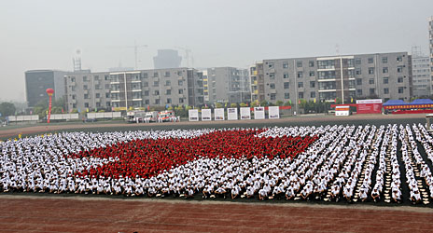
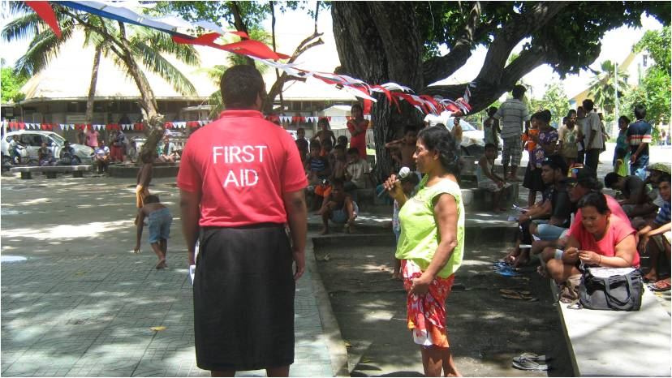
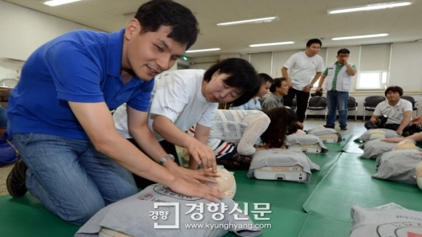
First Aid
World First Aid Day themes
2013 – FA and road safety
2014 – FA and daily disaster risks
2015 – FA and ageing population
2016 – One FA in the Movement

Slide 21
Emergency health 2014
NS are supported in the development of the health aspects of NDRT – from guidelines to trainings
Reviews planned
Emergency health specialisation training
ECV toolkit roll out projects
Platform for knowledge sharing on emergency health through e.g. Fednet and case studies/ evaluations
Review of Facilitate and provide platform for knowledge sharing on outbreak preparedness and response

Slide 22
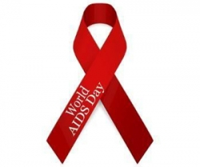
HIV highlights
HIV global alliance evaluation 2006-13
RCRC contributes substantially to the global response to the HIV epidemic through HIV NS programs implemented in more than 60 countries with improved PMER
The HIV GA did not achieve its target of doubling HIV programming between 2006 and 2010
Failed mobilization of additional financial resources for the HIV GA
Financial resources insufficient to ensure all the functions of the global HIV programme
Integration can be cost-effective and bring important potential gains but also carries risks and challenges
Regional networks are very effective for sharing knowledge and experience, improving NS HIV programming capacities

Slide 23
HIV highlights
HIV global strategy being renewed
International Conference on AIDS in Asia Pacific (ICAAP), November 2013, Bangkok
13 abstracts submitted from 9 NS (Thai RC excluded)
RCRC Symposium 21 November
ART meeting

Slide 24
HIV or Healthy lifestyle at the workplace
In low HIV prevalence area focus on “healthy living” rather than HIV

Slide 25
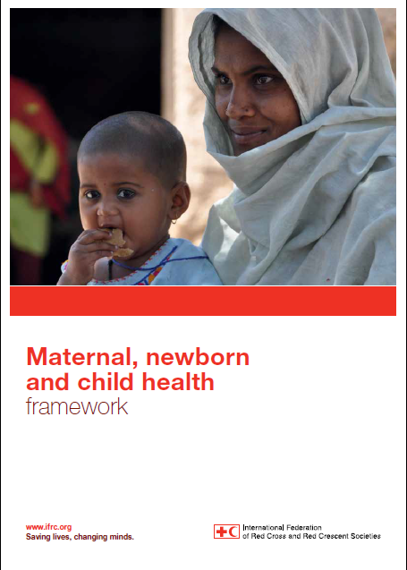
MNCH
MNCH Framework: how best to plan, strategize, design, implement and measure success in MNCH programmes
Mapping of MNCH services failed in 2012-13
MNCH global position being recruited
Nutrition agenda cross cutting (livelihoods, FS, NCD)

Slide 26
The role of the RC/RC in VNRBD
PMI, Lao, Phil, Thai
Cambodia, Malaysia, Myanmar, Vietnam
CVTL

Slide 27
VNRBD
New global VNRBD senior adviser in Geneva (after 2+years break)
Global Advisory Panel (GAP) transformed into independent organisation
GAP self assessment 2014
SEA VNRBD network vs zone network

Slide 28
VNRBD
The Seventh Red Cross and Red Crescent Symposium on Blood Programs in the Asian Region 22-24 January 2014
Organised by Thai TC +Japan RC
Brunei, Cambodia, Indonesia, Laos, Malaysia, Myanmar, Philippines, Singapore, Timor-Leste, Vietnam invited from SEA
VNRBD session from IFRC

Slide 29
Questions? Comments? Thank you.

