Slide 1
Myanmar Red Cross Society
Presentation to 16th RDMC

Slide 2
Structure of Disaster Management Division
HOD
Mg Mg Khin
HoD
Dy, HOD
San San Maw
Dy HoD
Program Coordinator
DPDR Unit
Program Coordinator
DRR Unit
GIRI Recovery Coordinator
Aung Thaung Shwe
PC(DPDR)
Htay Aung
PC (DPDR)
PC (Prppose)
UDRR
Phyo Zin Mar Wai
PC (DRR)
Engineer Unit
DM Officer
GIS Officer
Assistant Recovery Coordinator
HQ supporting
Admin Assistant
Kyaw San Win
DMO
Comm;
Officer
Logistics Officer
DRR Officer
FinanceOfficer
Field Team 1
Field Team 2
Shelter Field Technician
Livelihood Field Technician
A/ F Field Assistant

Slide 3
Capacity Mapping
General and Cross Cutting Areas
- out of 14 points, 2 was minimal and 4 was developing
- IDRL and IHL we need technical support
- For integration, MRCS planned to make CBDRM, CBHFA, Watsan programme with integrated approach

Slide 4
Capacity Mapping (cont)
Response Preparedness
- out of 14 points, 1 minimal and 8 as development
- emergency health capacity is mostly on FA services, HE, Health & care only. It is up on the health policy of the Government.
Support services for preparedness & Response
- pre-disaster supply agreement meeting is scheduled in July, 2012

Slide 5
Capacity Mapping (cont)
Disaster Risk Reduction & Long Term Development
- out of 6 points, 3 is developing. We also would like to make reliable EWS to reduce risk
Early Recovery and Long Term Recovery
- MRCS has less experience on recovery
- but MRCS used UNHABITAT standard for shelter and watsan unit is already existing under Health Division

Slide 6
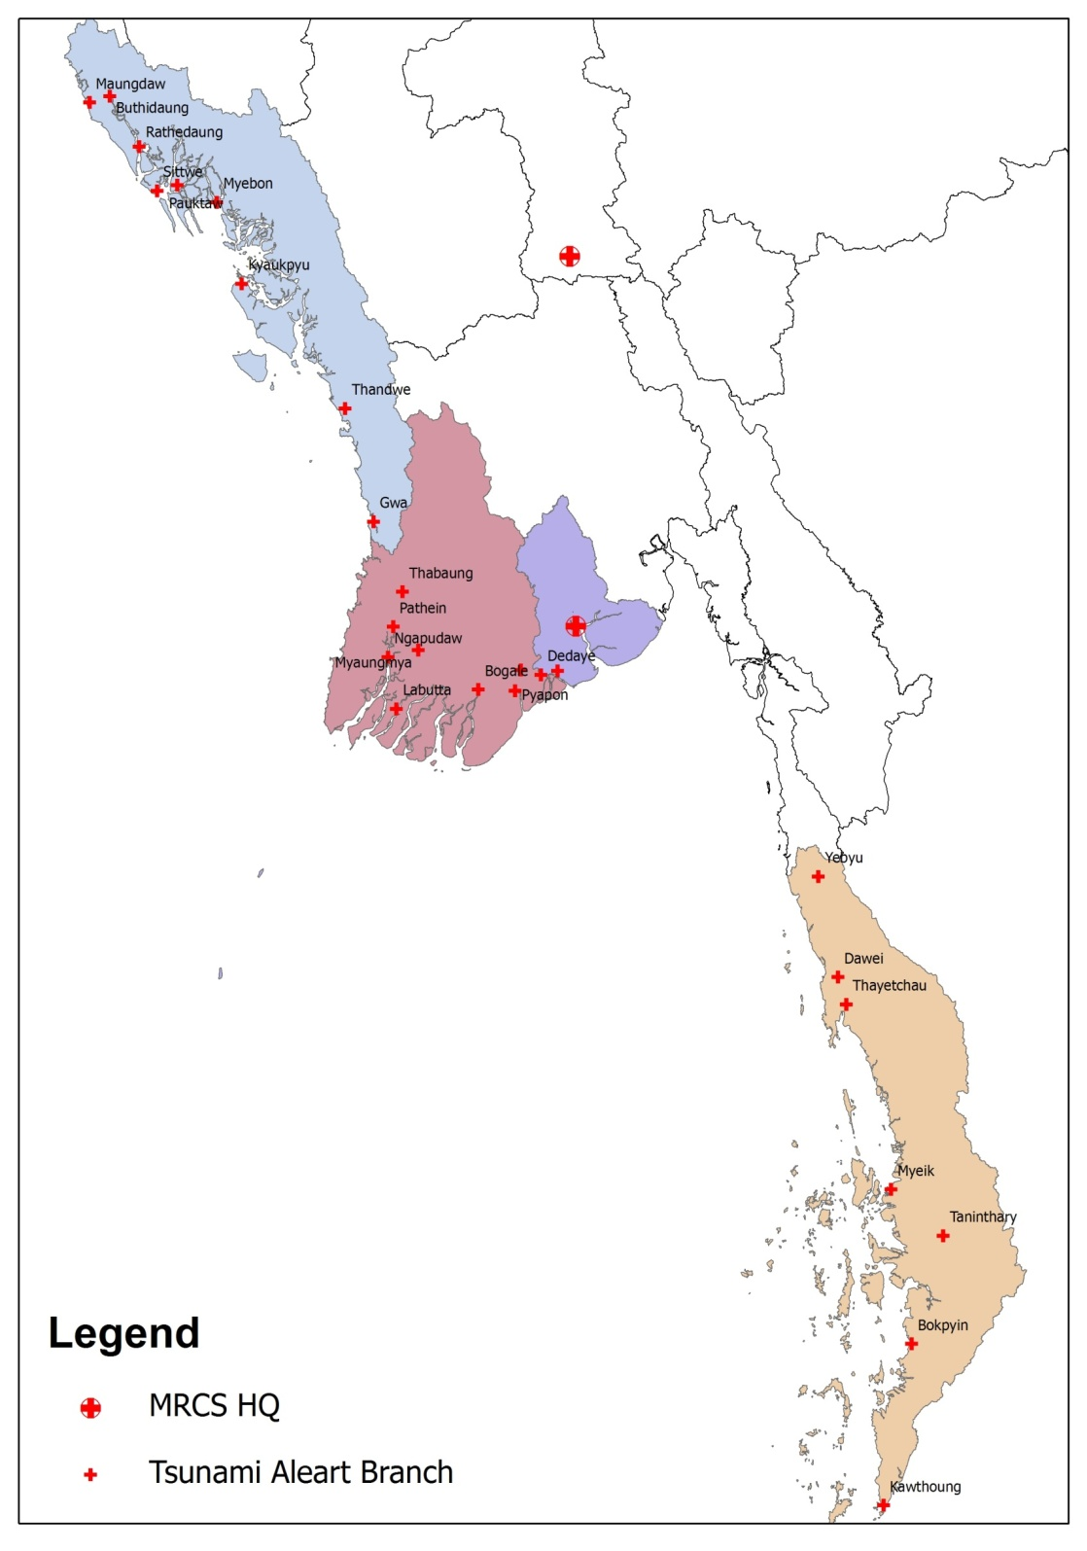
MRCS ‘ coverage area for(11.4.12 ) Tsumatra Eq & Tsunami EW
MRCS HQ
Yangon Branchaaa

Slide 7
Capacity Mapping (cont)
Knowledge Management
- al 3 points are developing and MRCS will make more on these areas
Partnerships
- in MAPDRR process and other activities, MRCS work closely with Gov
- MRCS now organizing Resource Mobilization through RM Unit for more improvement

Slide 8
Future Plan
Urban Disaster Risk Management as Pilot Program
EMF funding is under progress
CP review and will develop with two workshops
All activities may be based on Community based
Integrated approach, focus on ownership and sustainability

Slide 9
Challanges
Needed technical and Equipment for GIS application
Reliable EWS with end-to-end
Yearly programme Vs sustainability
Donor’s Requirement Vs NS/Community needs
Challenges on integration
RC Volunteers drop out

Slide 10
Thank You for kind Attention !

