Slide 1
MYRC DISASTER MANAGEMENT DEVELOPMENT
Rozalla Iskandar B Mohamad Rosni
Disaster Management & Preparedness Officer
MEMBER OF THE INTERNATIONAL FEDERATION OF RED CROSS AND RED CRESCENT SOCIETIES

Slide 2
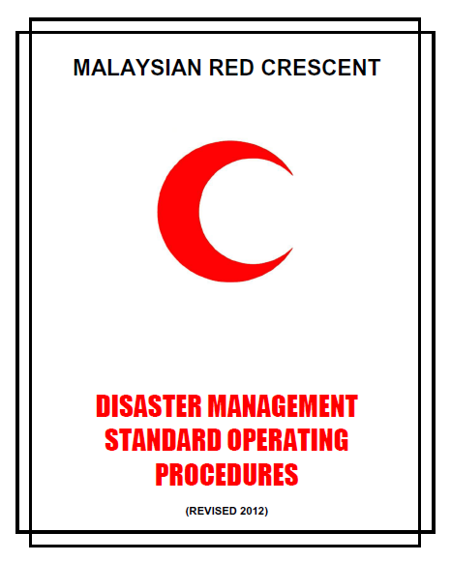
DISASTER MANAGEMENT GUIDELINES
MYRC Disaster Management and Standard Operating Procedures
(update every 2 years)
MEMBER OF THE INTERNATIONAL FEDERATION OF RED CROSS AND RED CRESCENT SOCIETIES

Slide 3
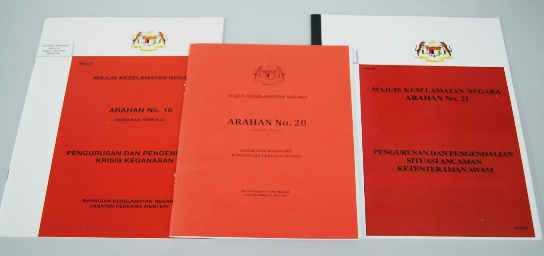
Malaysian National Security Council Directives
MEMBER OF THE INTERNATIONAL FEDERATION OF RED CROSS AND RED CRESCENT SOCIETIES

Slide 4
ROLES AND RESPONSIBILITY OF MALAYSIAN RED CRESCENT
HAS BEEN STATUTED IN THE MALAYSIAN GOVERNMENT
NATIONAL SECURITY COUNCIL (MKN) AS SUPPORTING AGENCY
DURING EMERGENCY OPERATION
(DIRECTIVE 18,20 AND 21)
MEMBER OF THE INTERNATIONAL FEDERATION OF RED CROSS AND RED CRESCENT SOCIETIES

Slide 5
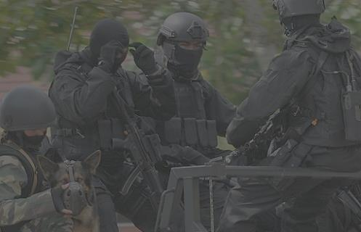
To Assist Emergency Medical Service
To prepare and provide food
First Aid service
MKN Directive No 18 (Revised July 2002)
Crisis and Violence Management
RIMR/CP/RDS11

Slide 6
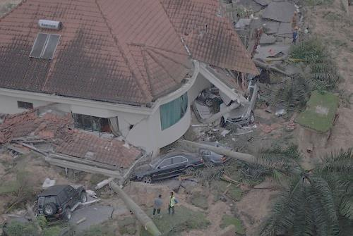
Assist the Ministry of Woman, Family and Social Development to provide food in relief centres, mass feeding by preparation and distribution of beneficiaries need such as clothing and blankets, registration and recovery for disaster victims.
Assist other agencies in rescue and evacuation of disaster beneficiaries.
Assist the Ministry of Health in providing first aid, ambulance service, medical services and health services at relief centres
MKN Directive No 20
(Revised March 2012)
National Disaster Management and Mechanism Policy
RIMR/CP/RDS11

Slide 7
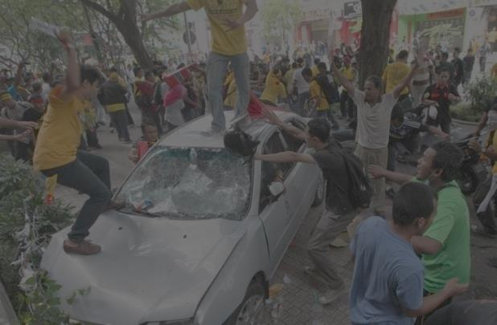
Assist the Ministry of Woman, Family and Social Development to Evacuate victims, mass feeding, manning Relief Centre, First Aid Service and Counseling.
Assist the Ministry of Health in providing first aid and Emergency Services,ambulance service, health services.
MKN Directive No 21 (2003)
Public Order and Threat Situation Management
RIMR/CP/RDS11

Slide 8
THREE (3) MAIN MINISTRY IN MKN WHICH MALAYSIAN RED CRESCENT DIRECTLY INVOLVED WITH:
MINISTRY OF HEALTH
MINISTRY OF WOMAN, FAMILY AND SOCIAL DEVELOPMENT
MAIN RESCUE AGENCIES (FIRE AND RESCUE DEPARTMENT,
EMERGENCY MEDICAL SERVICE, MALAYSIAN SMART TEAM)
MEMBER OF THE INTERNATIONAL FEDERATION OF RED CROSS AND RED CRESCENT SOCIETIES

Slide 9
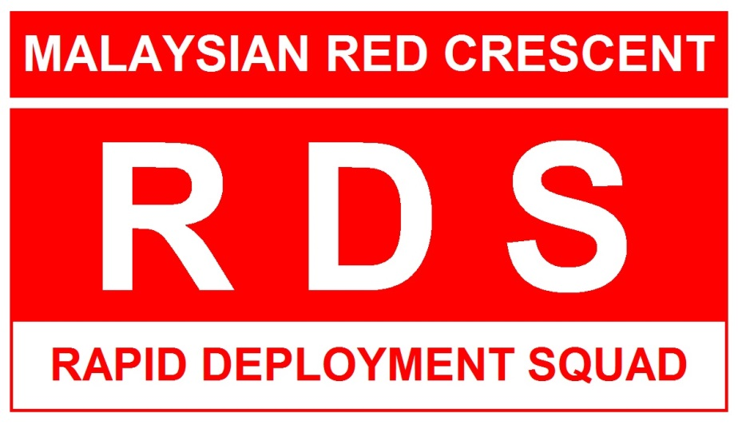
DEVELOPMENT OF MALAYSIAN RED CRESCENT
NATIONAL DISASTER RESPONSE TOOL
Well trained unit in disaster management and response
Unit were trained with the coordination from various main government agencies
Based on the Malaysian Red Crescent supporting roles to the government in Malaysian Security Council Directive 20
Involving volunteers and staff of MYRC
MEMBER OF THE INTERNATIONAL FEDERATION OF RED CROSS AND RED CRESCENT SOCIETIES

Slide 10
RDS (RAPID DEPLOYMENT SQUAD) VIDEO

Slide 11
Mobilization of Rapid Deployment Squad (RDS)
Under jurisdiction of MRC Sec General advised by Director of Operation and Disaster Management Unit
Mobilization procedures stated in the 2012 Revised Standard Operation Procedures

Slide 12
Team Composition
MRC Field Commander
/ RDS Commander
Rescue Boat Unit
(RBU)
MedSarev (Medic,Search Rescue and Evacuation)
RadCom
(Radio Communication)
Rescue Boat Handler
Assisting in rescue and evacuation
HF / VHF Radio Operator
Situation Reporting
Assisting in Med, Search and Rescue and Evacuation,
Rendering emergency service during operation especially in Yellow and Red Zone

Slide 13
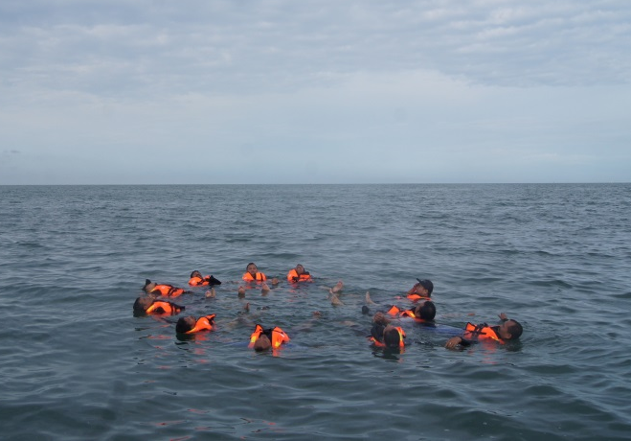
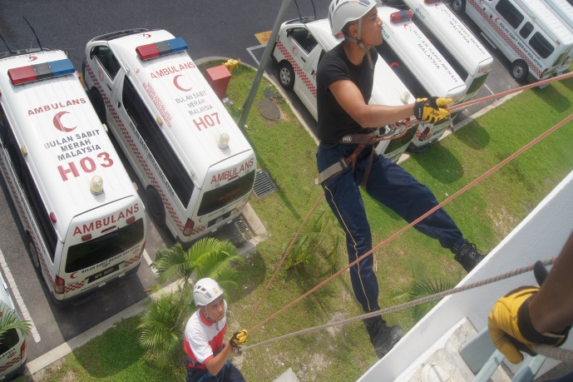
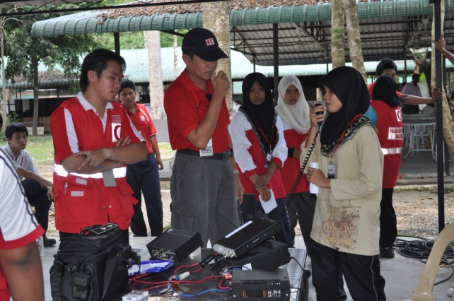
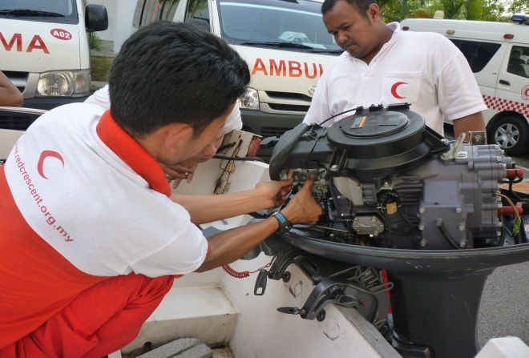
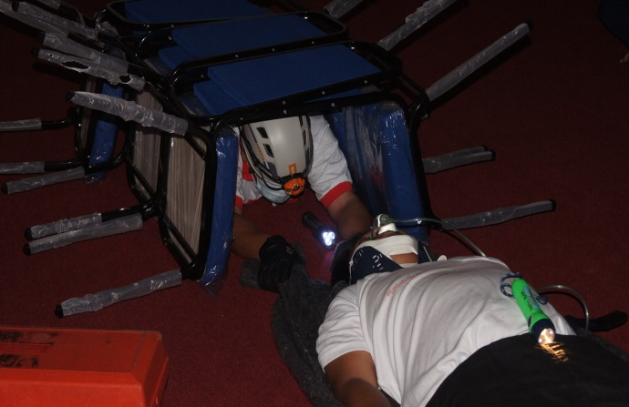
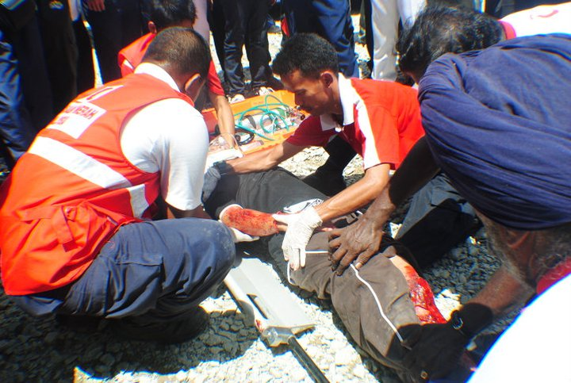
Rapid Deployment Squad (RDS) Training Component
WATER CONFIDENT AND RESCUE
ROPE RESCUE TECHNIQUE
RADCOM & PROTOCOL
TECHNICAL SKILLS
CONFINED SPACE RESCUE
MEDEVAC
MEMBER OF THE INTERNATIONAL FEDERATION OF RED CROSS AND RED CRESCENT SOCIETIES

Slide 14
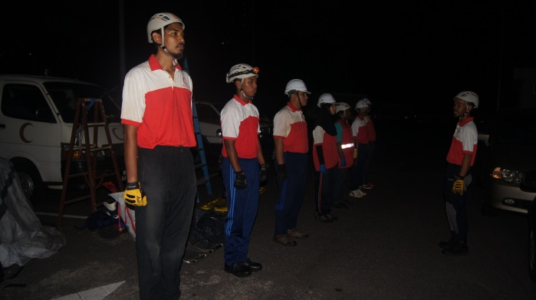
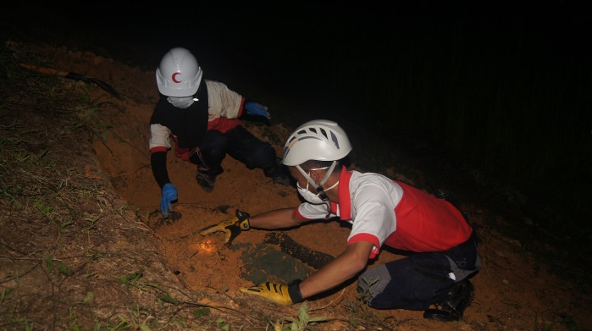
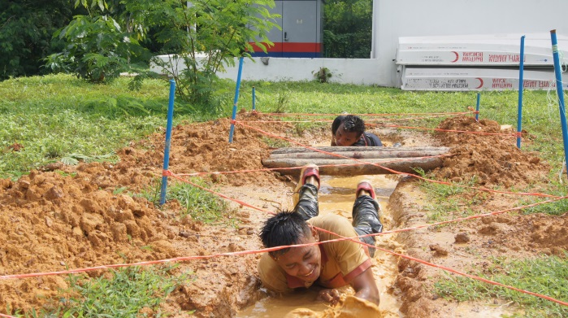
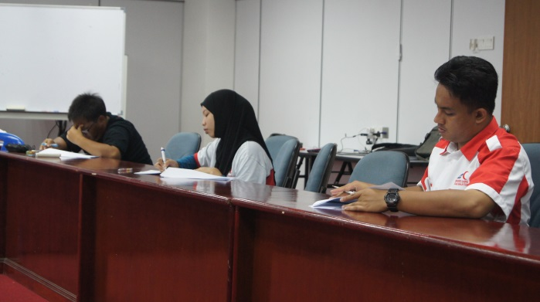
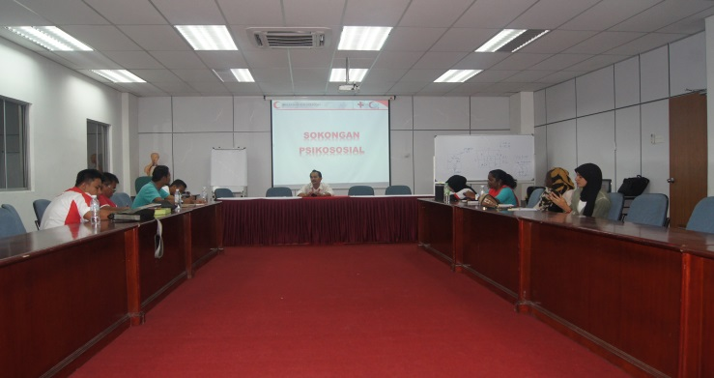
Rapid Deployment Squad (RDS) Training Component
SIMULATION AND DRILLS
SEARCH AND RESCUE
FITNESS AND ENDURANCE
EXAMINATION
PSYCHOSOCIAL SUPPORT
MEMBER OF THE INTERNATIONAL FEDERATION OF RED CROSS AND RED CRESCENT SOCIETIES

Slide 15
DM DEVELOPMENT IN NHQ
MALAYSIAN RED CRESCENT OD / TRAINING / DM INTERGRATION
PREPAREDNESS, CP AND SOP PLANNING BY DMU
RESPONSE AND MOBILIZATION OF RESOURCES
GUIDELINES AND SOP
MEMBER OF THE INTERNATIONAL FEDERATION OF RED CROSS AND RED CRESCENT SOCIETIES

Slide 16
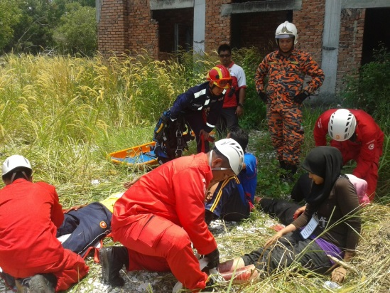
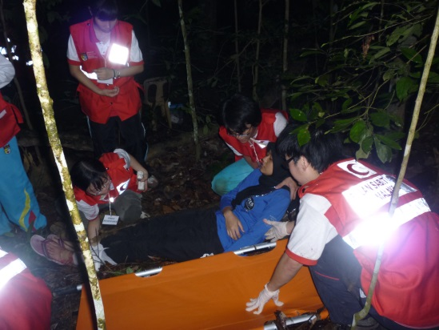
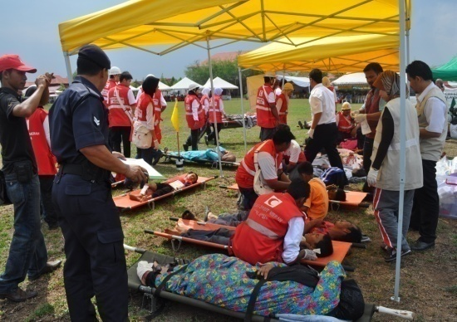
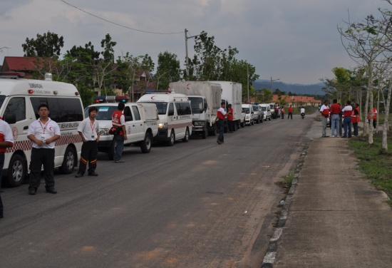
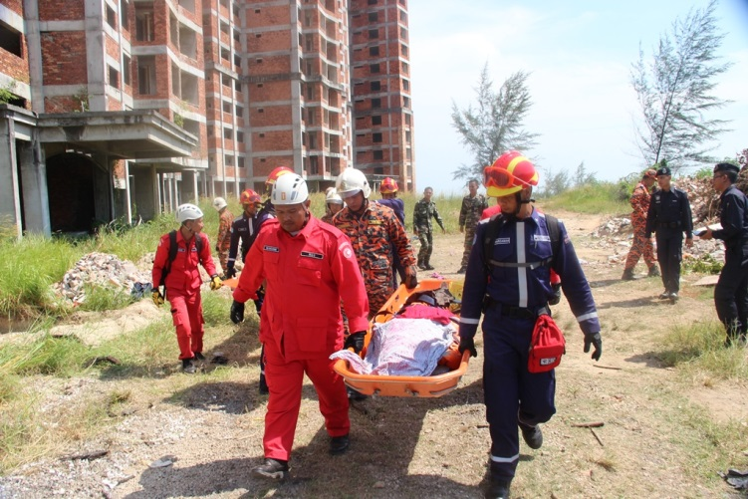
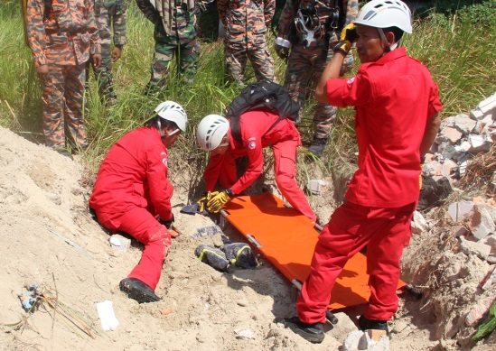
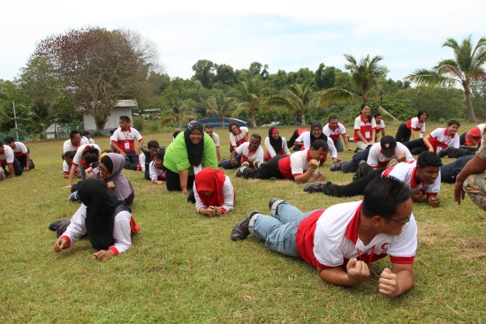
NATIONAL MYRC SIMULATION EXERCISE
(MRC-SIMEX)
MEMBER OF THE INTERNATIONAL FEDERATION OF RED CROSS AND RED CRESCENT SOCIETIES

Slide 17
MYRC DM SUPPORT ON DOMESTIC AND INTERNATIONAL RESPONSE
i. DOMESTIC OPERATION
RDS (Rapid Deployment Squad) units on :
MEDSAREV (Medical Search and Rescue Evacuation) during disaster and to support the needs in govt USAR response
RADCOM (Radio and Communication)
RBU (Rescue Boat Unit)
Based on the existing NSC Directive no 18,20,21
ii. INTERNATIONAL OPERATION SUPPORT
NS to NS humanitarian expertise support on disaster
Govt to Govt humanitarian operation support
MEMBER OF THE INTERNATIONAL FEDERATION OF RED CROSS AND RED CRESCENT SOCIETIES

Slide 18
NATIONAL USAR SIMULATION EXERCISE ORGANIZED BY MALAYSIAN FIRE AND RESCUE DEPT SPECIAL FORCE UNIT (STORM)
EX-STORM XIII 20 Sept 2014
MEMBER OF THE INTERNATIONAL FEDERATION OF RED CROSS AND RED CRESCENT SOCIETIES

Slide 19
MYRC DM MUTUAL APPROACH
MEMBER OF THE INTERNATIONAL FEDERATION OF RED CROSS AND RED CRESCENT SOCIETIES

Slide 20
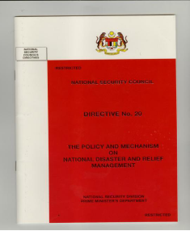
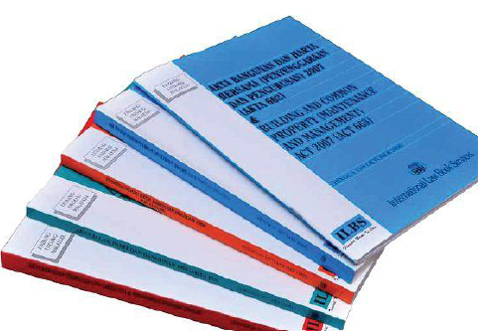
The Mutual DM and DP Approach
i. AUTHORITY LEVEL POLICY
Guidelines in handling disaster in Malaysia is based on the official document called „The Policy and Mechanism on National Disaster and Relief management under Directive 20 National Security Council. The purpose is to:
Mitigate the effects of various hazards
Prepare for measures that will preserve life and minimise damage to the environment
Respond during emergencies and provide assistance
Establish a recovery system to ensure the affected community's return to normalcy.
Directive Guideline
Other related documents)
MEMBER OF THE INTERNATIONAL FEDERATION OF RED CROSS AND RED CRESCENT SOCIETIES

Slide 21
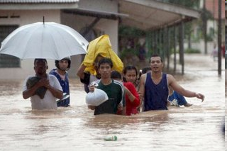
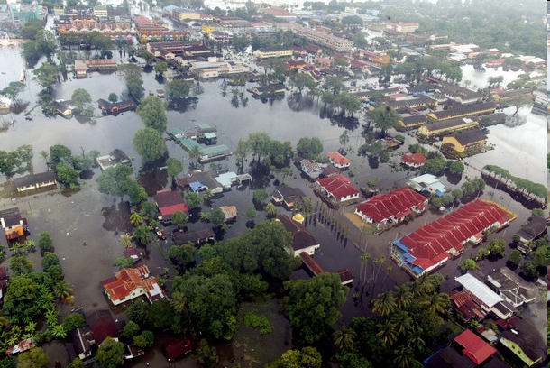
Natural hazards as an important subject in the disaster preparedness development and one of the cross cutting issues in the country’s risk reduction plan
Mitigation step has been taken to every level especially towards vulnerable communities in risk areas by government preparedness and mitigation plans
Malaysian Red Crescent and local agencies have been working together in response and preparedness activities; highlighting community preparedness level and support mechanism.
MEMBER OF THE INTERNATIONAL FEDERATION OF RED CROSS AND RED CRESCENT SOCIETIES

Slide 22
DISASTER EARLY WARNING SYSTEM IN MALAYSIA
GOVT DISASTER EARLY WARNING SYSTEM
TSUNAMI AND EARTHQUAKE
National Tsunami Early Waning System (SAATNM)
17 Seismological station in Malaysia ( 7 short period sensor and 10 broadband sensor.
2 deep ocean buoy equipped with tsunami meter instrument
Data transmitted to Malaysia Meteorological Dept HQ in PJ via VSAT satellite
Shared with other agencies
LANDSLIDE AND EROSION HAZARD
Surface Monitoring Technique at hill slope
System monitored by JKR Dept
Shared with other agencies
FLOOD
River water level Indicator and gauge
Monitored by JKR Dept
Shared with other agencies
MEMBER OF THE INTERNATIONAL FEDERATION OF RED CROSS AND RED CRESCENT SOCIETIES

Slide 23
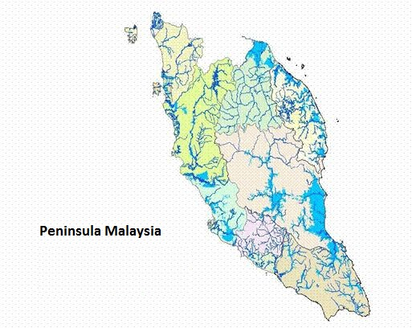
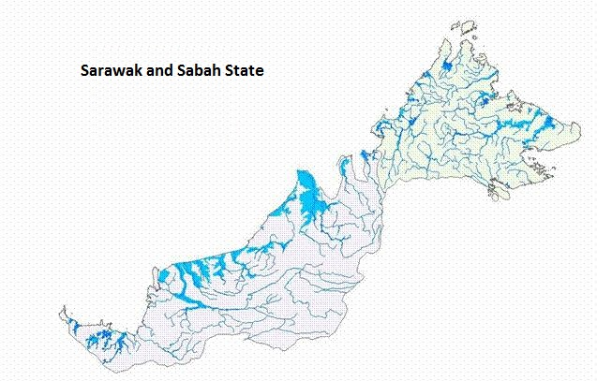
Fig 1. Hydrographic basin and flood hazard in Malaysia
MEMBER OF THE INTERNATIONAL FEDERATION OF RED CROSS AND RED CRESCENT SOCIETIES

Slide 24
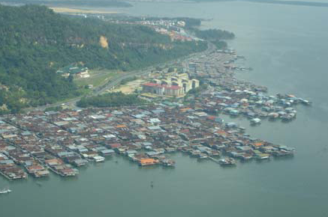
Fig 2. Example of risk community in some state of Malaysia
MEMBER OF THE INTERNATIONAL FEDERATION OF RED CROSS AND RED CRESCENT SOCIETIES

Slide 25
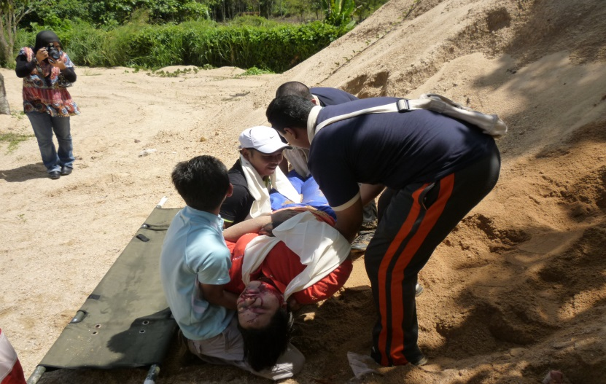
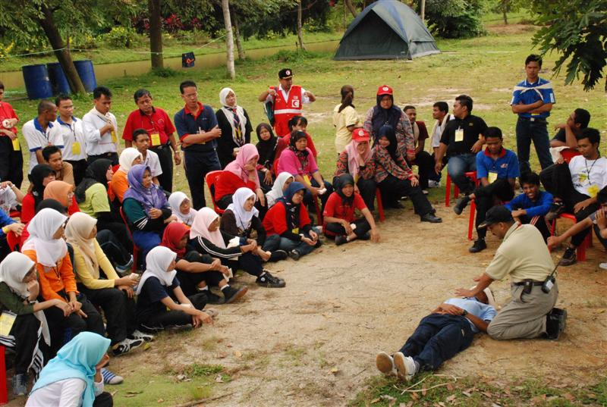
ii. COMMUNITY LEVEL
Yearly estimations around 29,800 sq kilometres are flooded affecting 4.82 million people, causing physical damages.
Capacity building for disaster prone areas and risk community also highlighted; establishment of Community Based Action Team (CBAT) by Malaysian Red Crescent with the collaboration of local agencies.
Community Based Disaster Management programs has been carried out by the government and also Malaysian Red Crescent, disseminating and giving training to disaster prone community on response and management
Higher Learning Institutions approach strategies by DMU by starting from root level
MEMBER OF THE INTERNATIONAL FEDERATION OF RED CROSS AND RED CRESCENT SOCIETIES

Slide 26
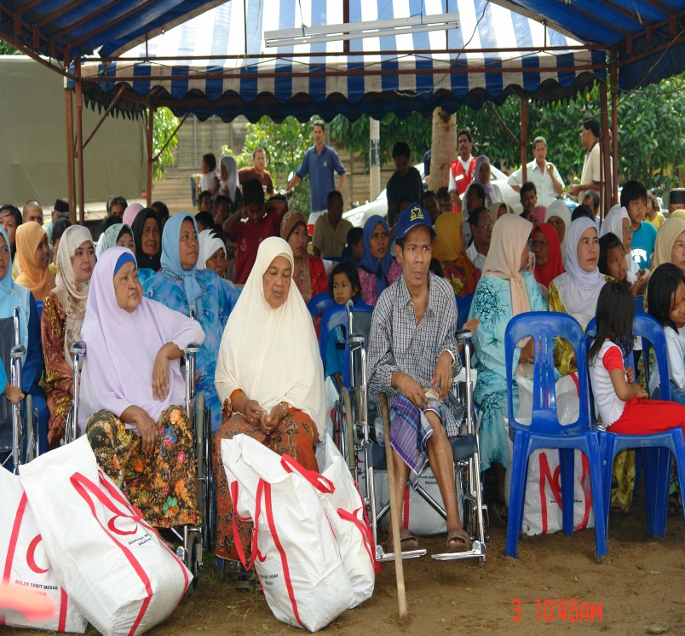
1. Implementation Of Community Disaster Awareness
- Workshops, talks and exhibitions to disseminate the community and ensure their understanding on the meaning of disaster risk reduction and the need of the community to actively engage in such efforts.
- The community learn about disaster, risk reduction, and assessment of vulnerability / capacity of their areas.
MEMBER OF THE INTERNATIONAL FEDERATION OF RED CROSS AND RED CRESCENT SOCIETIES

Slide 27
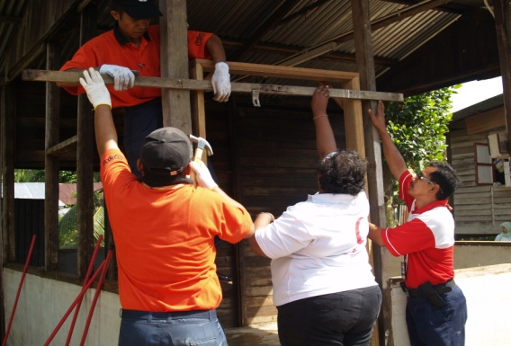
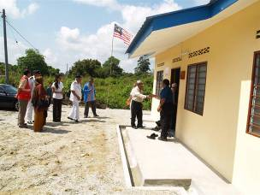
2. Community-level Mitigation Programs
a. Structural Mitigation
Construction of a community multipurpose center in an area of high elevation. This serve as an evacuation center in the event of emergencies by getting support from local donors and government (eg. Kuala Muda, Kedah and Kampung Peta, Johore)
Reconstruction of better shelters for affected communities (eg. Kampung Peta, Johore)
Construction of Community Resource Centre (CRC) for risk community in joint projects with local donors and firms
MEMBER OF THE INTERNATIONAL FEDERATION OF RED CROSS AND RED CRESCENT SOCIETIES

Slide 28
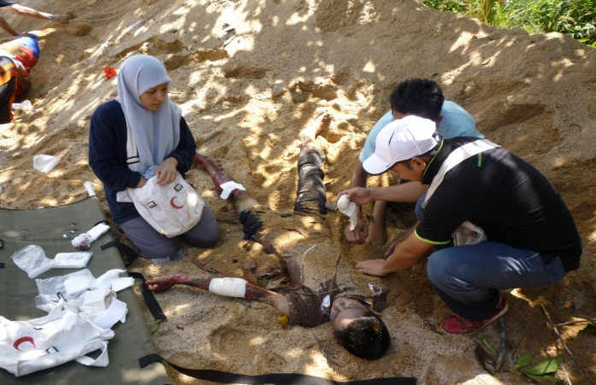
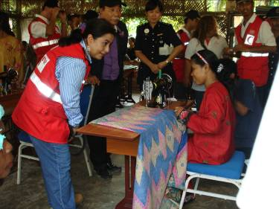
b. Non-structural Mitigation
Disaster Awareness programs in partnership with NGOs,
state/districts governments and local firms
- Recruitment of community volunteers as CBAT members
- Undertake DM training programs for CBAT members
Livelihood and community economic sustain programs
(Kuala Muda, Kedah and Kampung Peta, Johore)
MEMBER OF THE INTERNATIONAL FEDERATION OF RED CROSS AND RED CRESCENT SOCIETIES

Slide 29
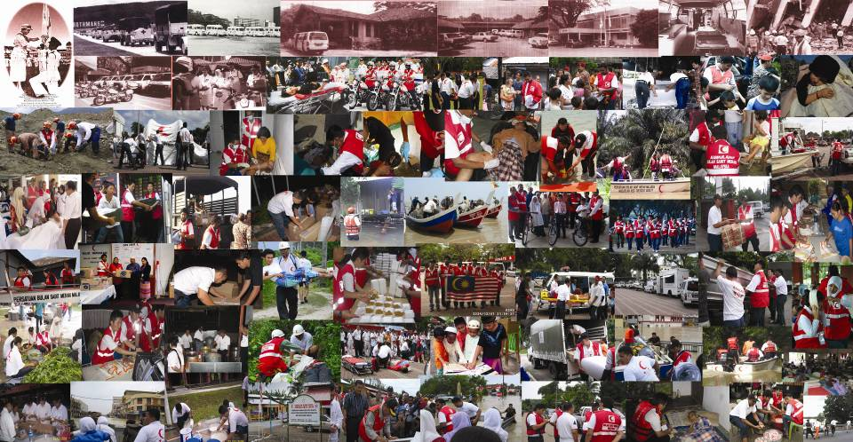
THANK YOU
MEMBER OF THE INTERNATIONAL FEDERATION OF RED CROSS AND RED CRESCENT SOCIETIES

